Slide 1

Node centralities
Ilia Karpov (iakarpov@hse.ru)
Moscow, 2021

Slide 2
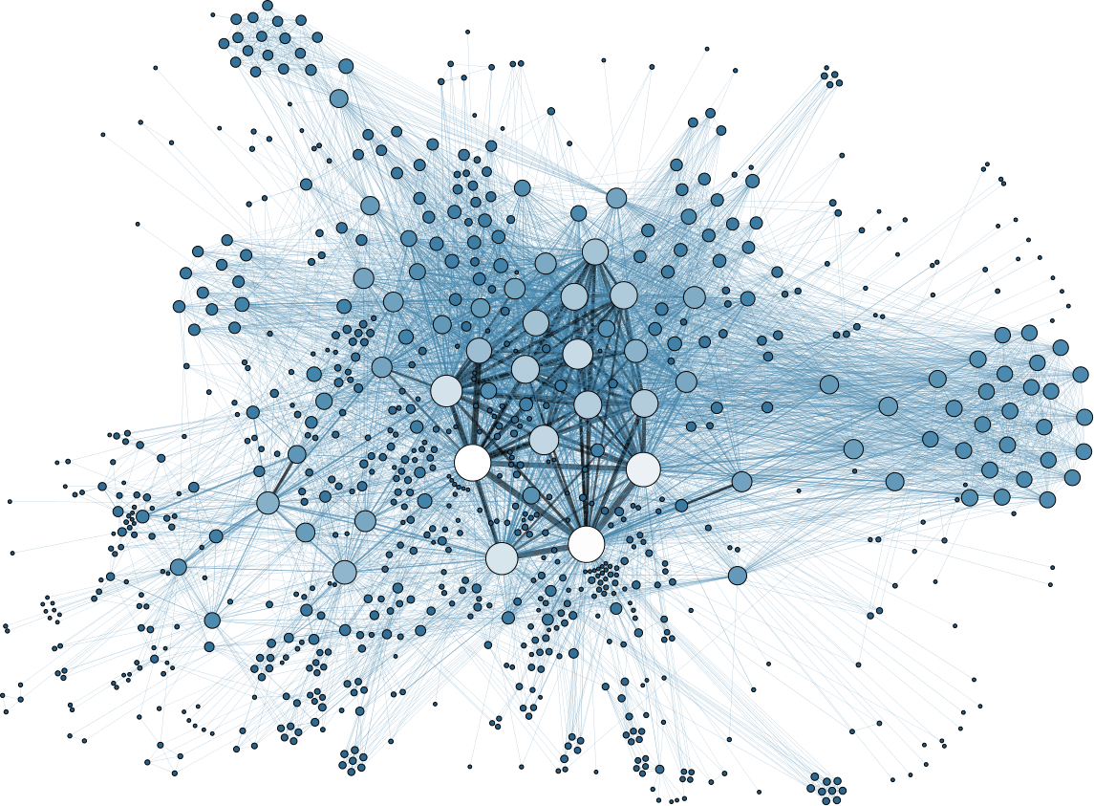
introduction
centralities examples
Which vertices are important?

Slide 3
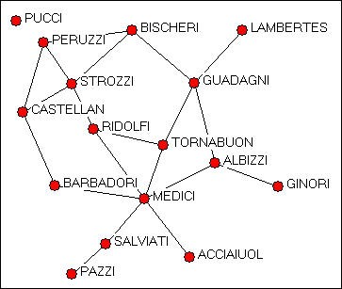
introduction
centralities examples
Determine the most ”important” or ”prominent” actors in the network based on actor location.
Marriage alliances among leading Florentine families 15th century.

Slide 4
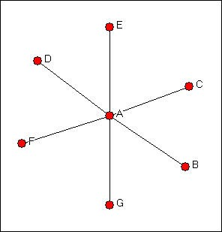
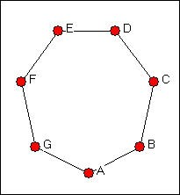
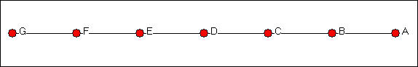
introduction
Three graphs
Star graph
Circle graph
Line Graph

Slide 5
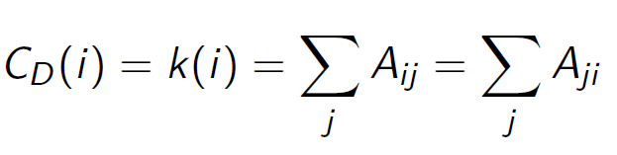
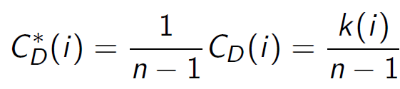
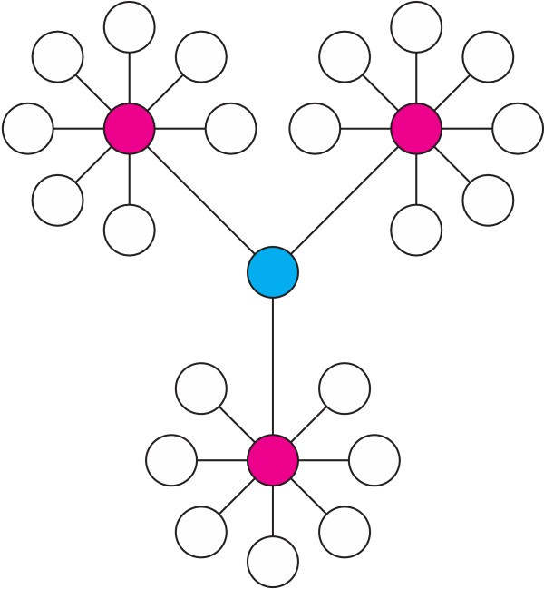
Degree centrality
Degree centrality: number of nearest neighbors
Normalized degree centrality
High centrality degree -direct contact with many other actors

Slide 6
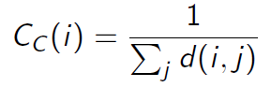
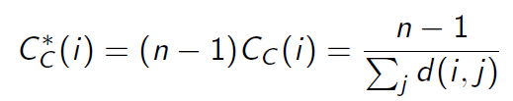
Closeness centrality
Closeness centrality: how close an actor to all the other actors in network
Normalized closeness centrality
High closeness centrality - short communication path to others, minimal number of steps to reach others

Slide 7
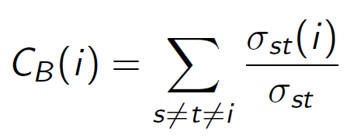
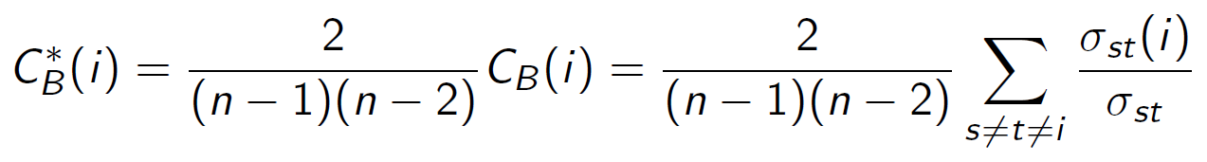
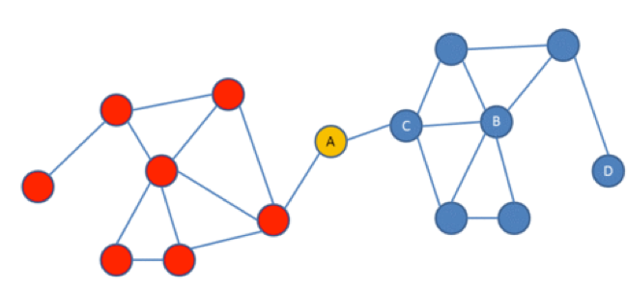
Betweenness centrality
Betweenness centrality: number of shortest paths going through the actor σ_{st}(i)
Normalized betweenness centrality
Hight betweenness centrality - vertex lies on many shortest paths Probability that a communication from s to t will go through i

Slide 8
Bow-tie structure

Slide 9
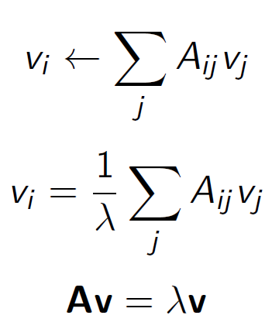
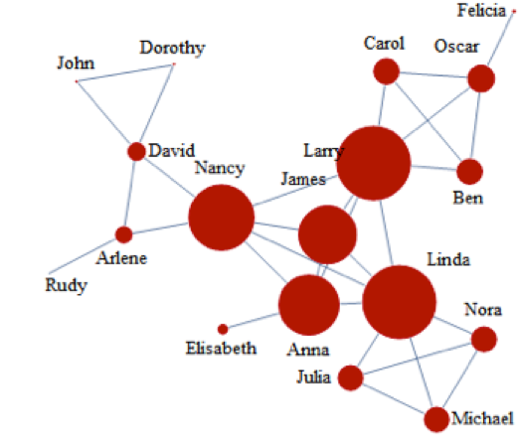
Eigenvector centrality
Importance of a node depends on the importance of its neighbors (recursive definition)
Select an eigenvector associated with largest eigenvalue λ = λ₁, v = v₁

Slide 10
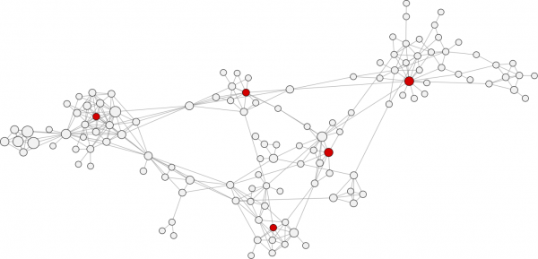
Closeness centrality
Centrality examples
from www.activenetworks.net

Slide 11
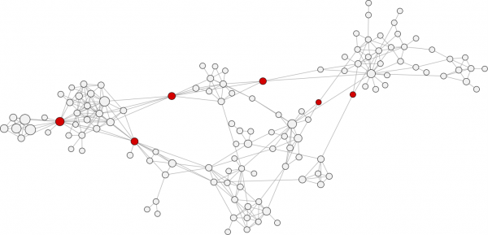
Betweenness centrality
Centrality examples
from www.activenetworks.net

Slide 12
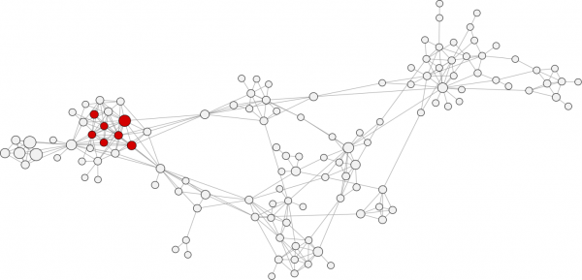
Eigenvector centrality
Centrality examples
from www.activenetworks.net

Slide 13
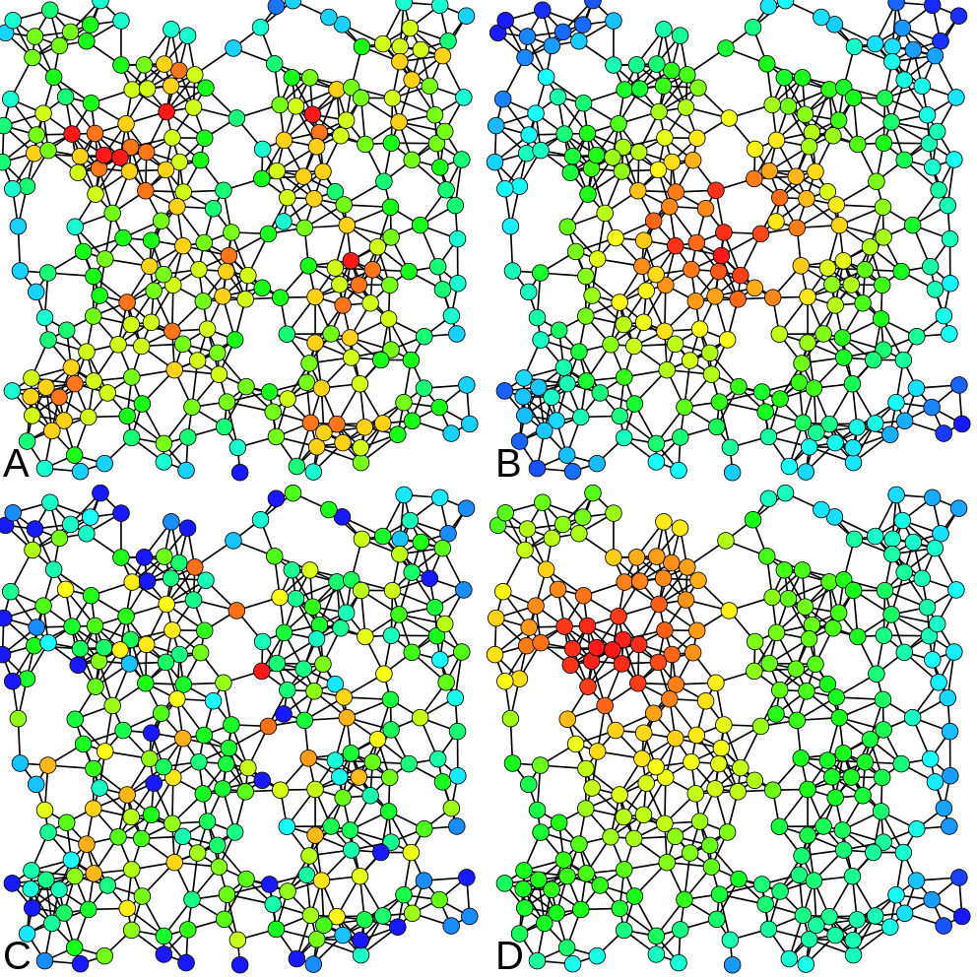
Centrality examples
A) Degree centrality
B) Closeness centrality
C) Betweenness centrality
D) Eigenvector centrality
from Claudio Rocchini

Slide 14
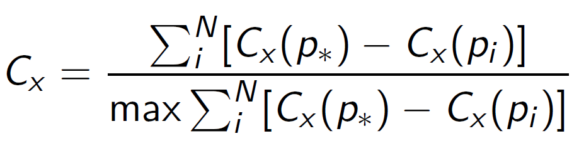
Centralization
Centralization (network measure) - how central the most central node in the network in relation to all other nodes.
C_{x} - one of the centrality measures
p∗ - node with the largest centrality value
max - is taken over all graphs with the same number of nodes (for degree, closeness and betweenness the most centralized structure is the star graph)
Linton Freeman, 1979
Notes:
Показать звездочку против цикла

Slide 15
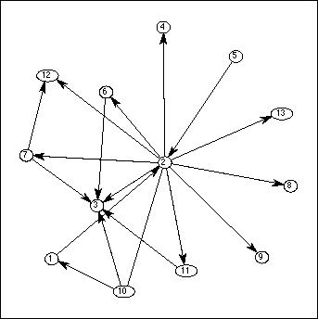
Directional relations
Directed graph: distinguish between choices made (outgoing edges) and choices received (incoming edges)
sending - receiving export - import
cite papers - being cited

Slide 16
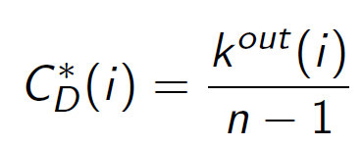
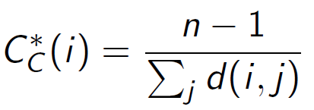
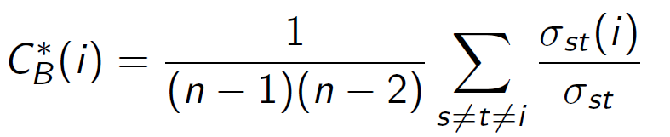
Centrality measures
All based on outgoing edges
Degree centrality (normalized):
Closeness centrality (normalized):
Betweenness centrality (normalized):

Slide 17
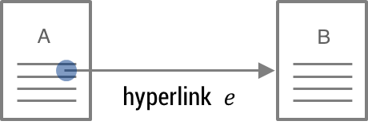
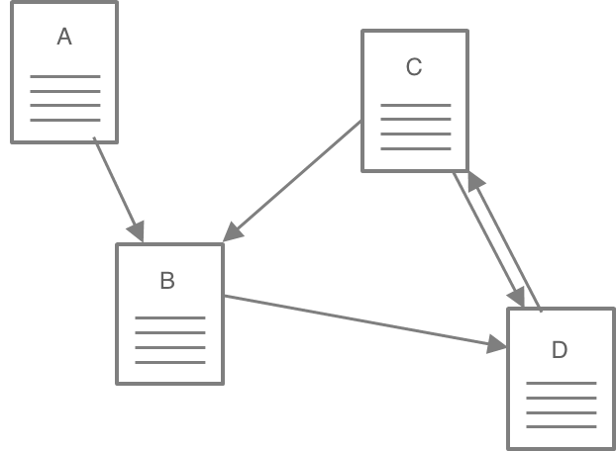
Web as a graph
Hyperlinks - implicit endorsements
Web graph - graph of endorsements (sometimes reciprocal)

Slide 18
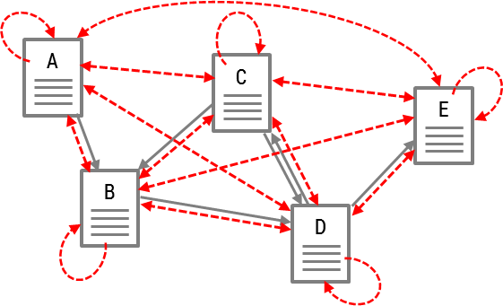
PageRank
”PageRank can be thought of as a model of user behavior. We assume there is a ”random surfer” who is given a web page at random and keeps clicking on links, never hitting ”back” but eventually gets bored and starts on another random page. The probability that the random surfer visits a page is its PageRank.”
Sergey Brin and Larry Page, 1998

Slide 19
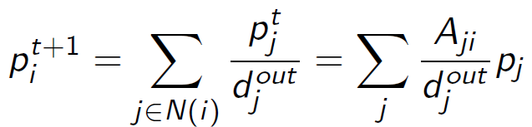
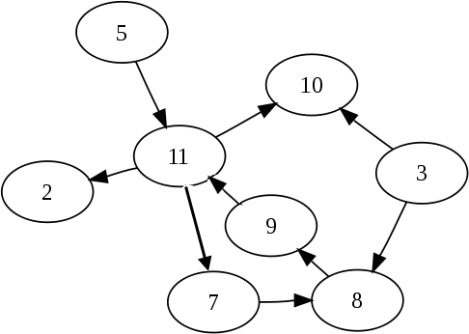
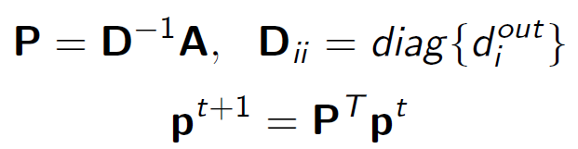
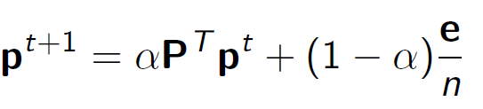
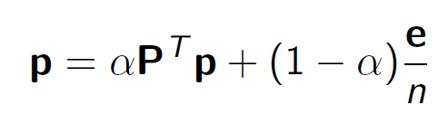
Random walk
Random walk on graph
with teleportation
Perron-Frobenius Theorem guarantees existence and uniqueness of the solution lim_{t→∞} p = π

Slide 20
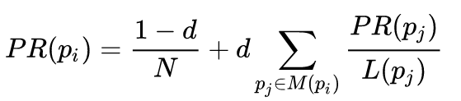
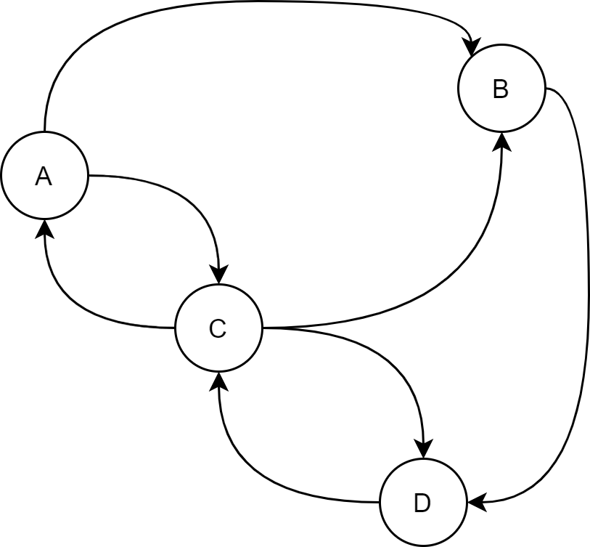
Pagerank
 | it. 0 | it 1 | it 2 | PR
A | ¼ | 1/12 | 1.5/12 | 1
B | ¼ | 2.5/12 | 2/12 | 2
C | ¼ | 4.5/12 | 4.5/12 | 4
D | ¼ | 4/12 | 4/12 | 3

Slide 21
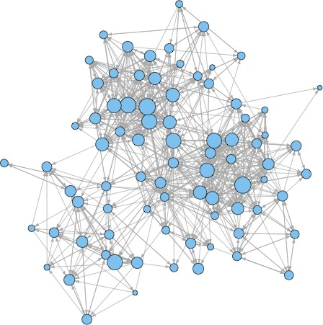
PageRank

Slide 22
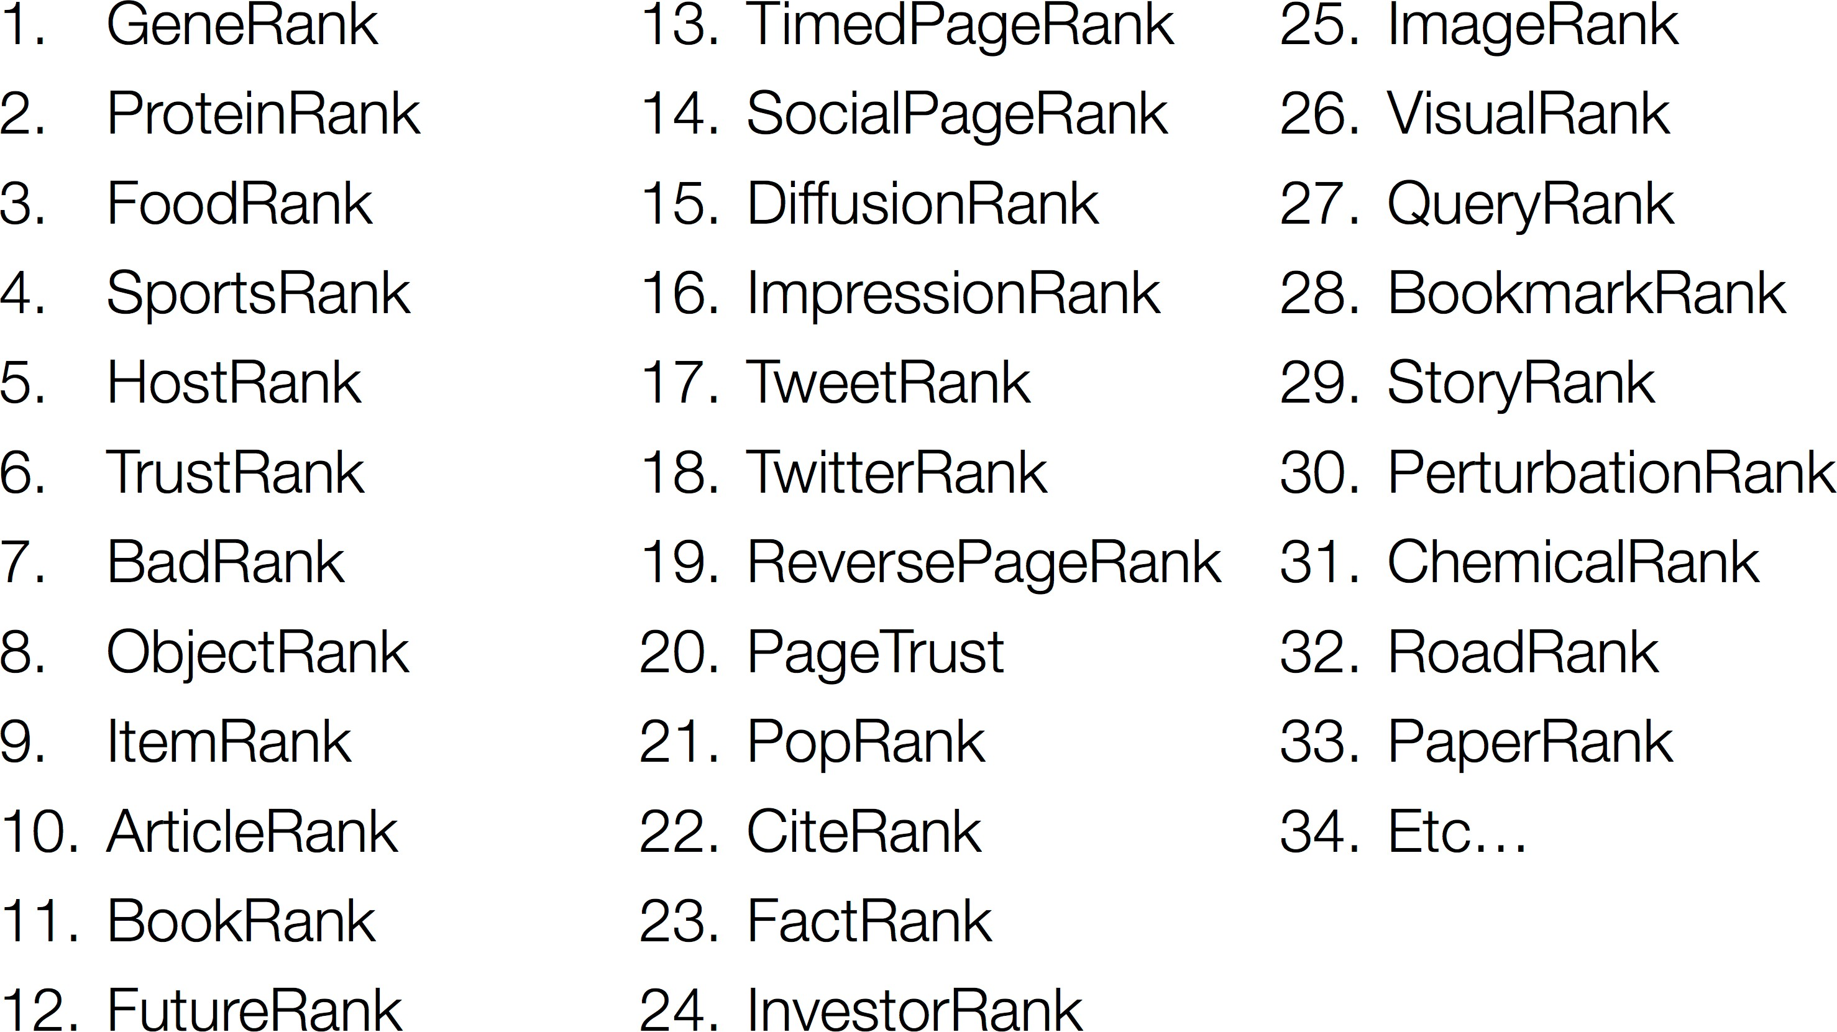
PageRank beyond the Web

Slide 23
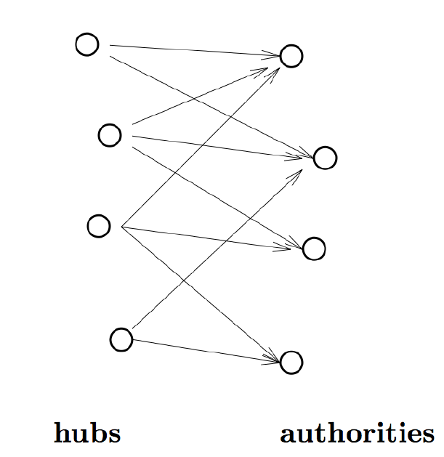
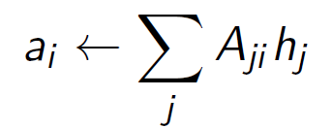
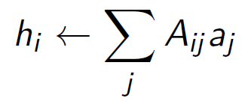
Hubs and Authorities (HITS)
Citation networks. Reviews vs original research (authoritative) papers
authorities, contain useful information, ai
hubs, contains links to authorities, hi
Mutual recursion
good authorities referred by good hubs
good hubs point to good authorities

Slide 24
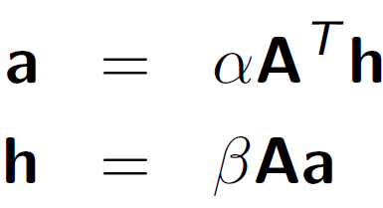
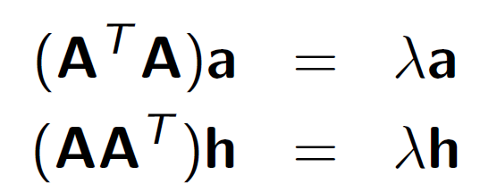
Hubs and Authorities (HITS)
System of linear equations
Symmetric eigenvalue problem
where eigenvalue λ = (αβ)⁻¹

Slide 25
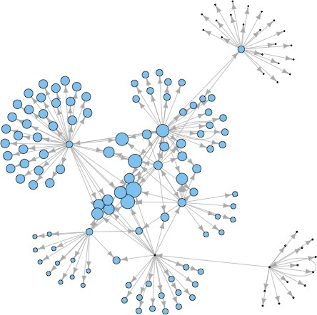
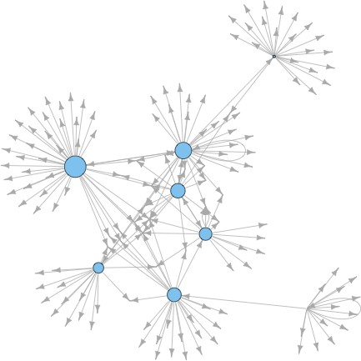
Hubs and Authorities (HITS)
Hubs and Authorities
Hubs
Authorities

Slide 26
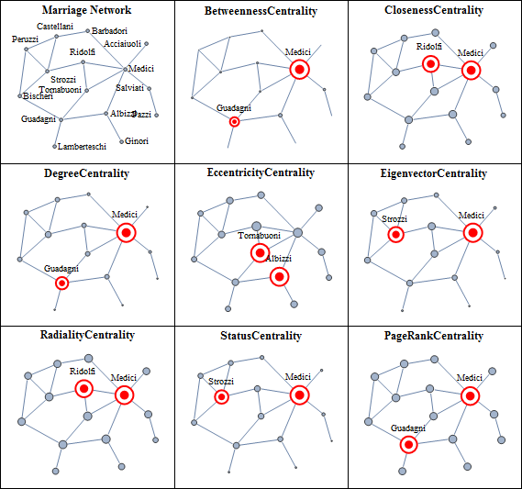
CENTRALITIES
Florentines families

Slide 27
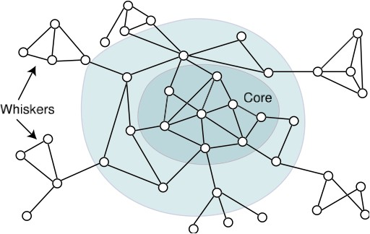
Core-periphery structure
Typical network structure
image from J. Leskovec, K. Lang, 2010

Slide 28
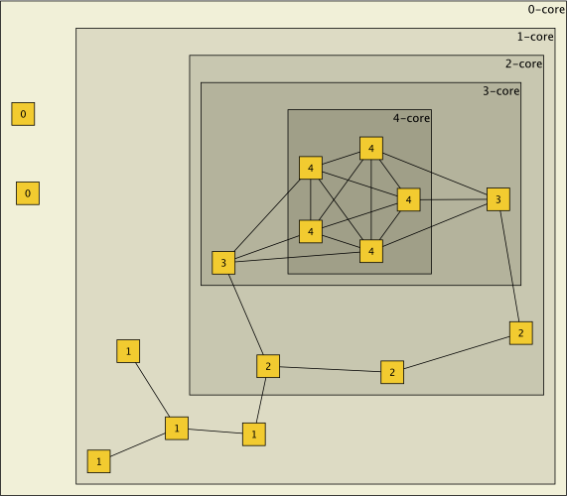
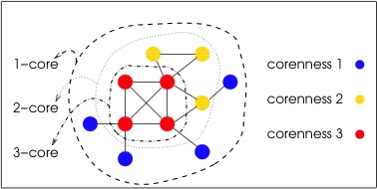
Graph cores
Definition
A k-core is the largest subgraph such that each vertex is connected to at least k others in subset
Every vertex in k-core has a degree k_{i} ≥ k
(k + 1)-core is always subgraph of k-core
The core number of a vertex is the highest order of a core that contains this vertex

Slide 29
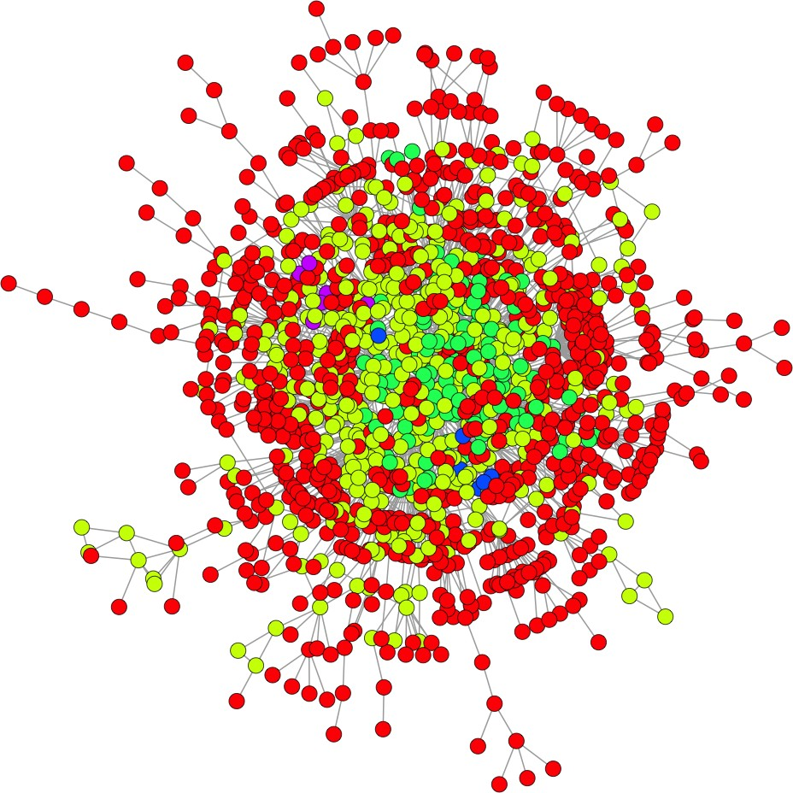
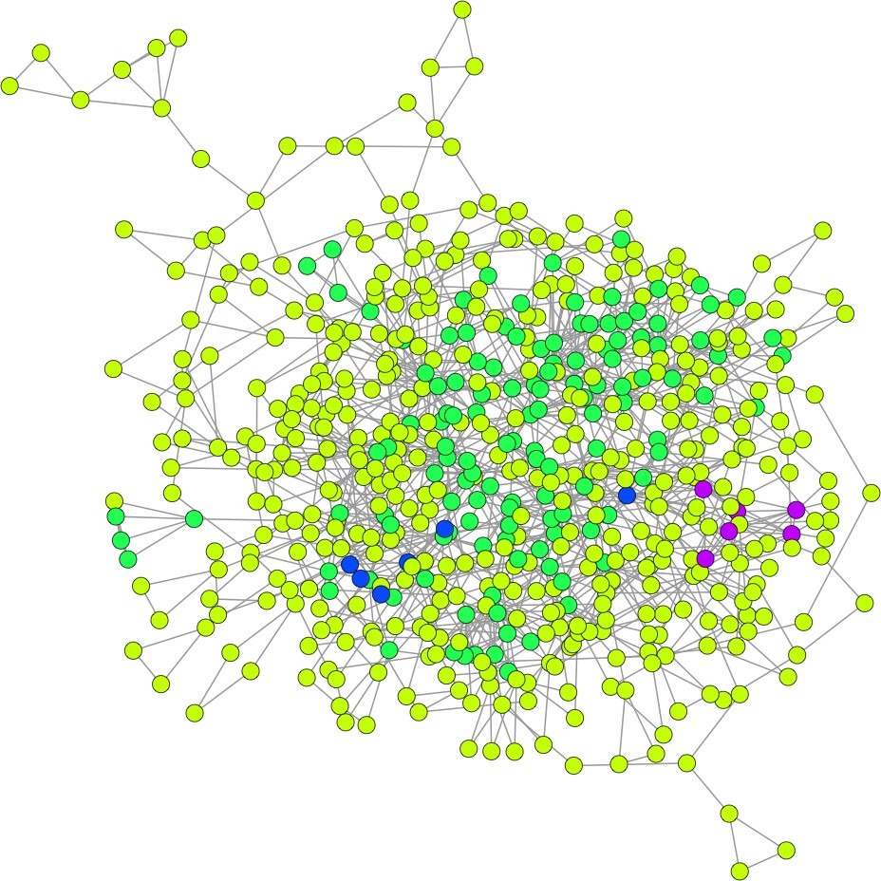
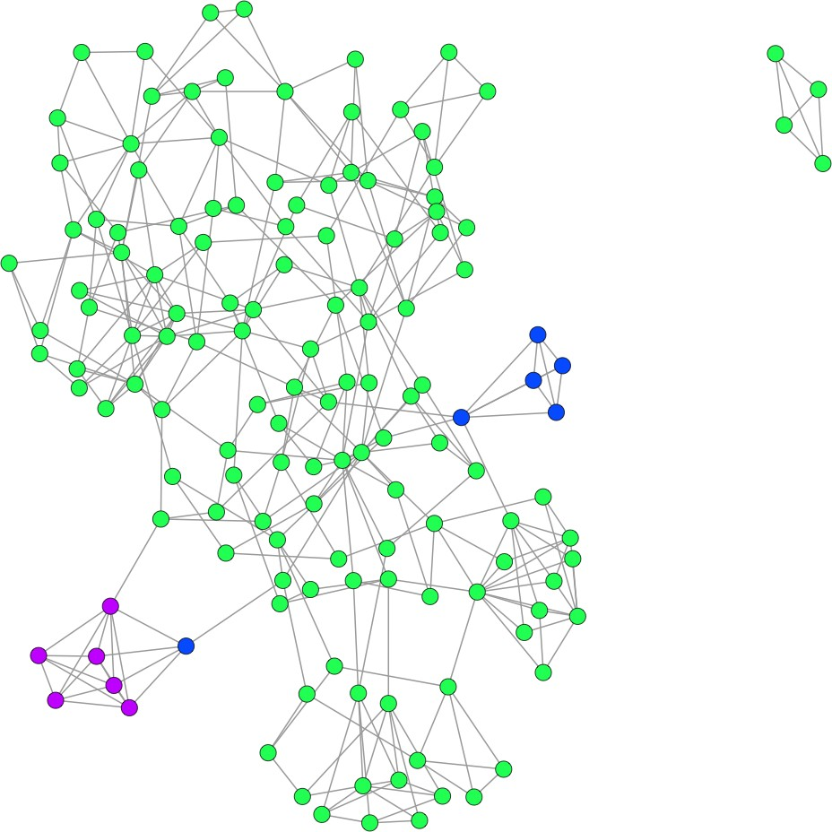


k-cores
k-cores: 1:1458, 2:594, 3:142, 4:12, 5:6
k-shells: 1:864-red, 2:452-pale green, 3:130-green, 5:6-blue, 6:6-purple
R:graph.coreness(gcc)
Leonid E. Zhukov (HSE)

Slide 30

k-cores
Find 3-core of the given network

Slide 31

Dyads
Dyad is a pair of vertices and possible relational ties between them:
mutual
asymmetric
null (non-existent)

Slide 32

Triads
Triad is a subgraph of three vertices and possible ties between them:
Triad census :16 isomorphism classes
D - down, U - up, T - transitive, C - cyclic.
| mutual diads | assymetric dyads | null dyads |

Slide 33

Network motifs
Definition
Network motifs are recurrent statistically significant subgraphs or patterns in graphs connected subgraphs that (compare to random network)
Motifs are not induced subgraphs, i.e. they do not contain all the graph edges between selected vertices.

Slide 34
Network motifs
Motifs appear in a network more frequently than in a comparable random network
calculate the number of occurrences of a sub graph evaluate the significance
For G^{t} subgraph (motif candidate) of G ,
_{(Gt) =} F_{G} (G^{t}) − µ_{R} (G^{t})
Z
score
σ_{R} (G^{t})
R - random graph, µ - mean frequency, σ-standard deviatiom

Slide 35

Network motifs
Network motifs
Undirected graphs: motifs of size 3 and 4

Slide 36


Network motifs
Network motifs
Connected triads - motifs of size 3
More complicated motifs:
Ribeiro, 2011, Shen-Orr, 2002

Slide 37

Network motifs
Network motifs
S. Omidi, 2009

Slide 38

Network motifs
Network motifs
Ribeiro, 2011, Milo, 2002

Slide 39

Network motifs
Network motifs
146 nodes, 187 edges

Slide 40

Network motifs
Network motifs

Slide 41

Network motifs
Network motifs

Slide 42
References
Centrality in Social Networks. Conceptual Clarification, Linton
C. Freeman, Social Networks, 1, 215-239, 1979
Power and Centrality: A Family of Measures, Phillip Bonacich, The American Journal of Sociology, Vol. 92, No. 5, 1170-1182, 1987
A new status index derived from sociometric analysis, L. Katz, Psychometrika, 19, 39-43, 1953.
Eigenvector-like measures of centrality for asymmetric relations, Phillip Bonacich, Paulette Lloyd, Social Networks 23, 191-201, 2001
The PageRank Citation Ranknig: Bringing Order to the Web. S. Brin, L. Page, R. Motwany, T. Winograd, Stanford Digital Library Technologies Project, 1998
Authoritative Sources in a Hyperlinked Environment. Jon M. Kleinberg, Proc. 9th ACM-SIAM Symposium on Discrete Algorithms
A Survey of Eigenvector Methods of Web Information Retrieval. Amy N. Langville and Carl D. Meyer, 2004
PageRank beyond the Web. David F. Gleich, arXiv:1407.5107, 2014

